Slide 1
Neural networks and Support Vector Machine (SVM)

Slide 2
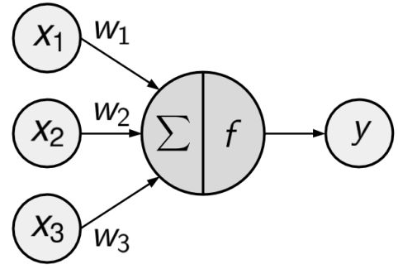
(Artificial) Neural networks
An activation function, which transforms a neuron's net input signal into a single output signal to be broadcasted further in the network.
A network topology (or architecture), describes:
The number of layers
The number of nodes in each layer
Whether information is allowed to travel backward.
The training algorithm that specifies how connection weights are set in order to inhibit or excite neurons in proportion to the input signal

Slide 3
Applications
Speech and OCRs
Automation of office building’s environmental control, self-driving cars, drones
Facial recognition
Weather and climate patterns
Can be used for classification, numeric prediction, and even unsupervised pattern recognition

Slide 4
Threshold Activation Function—Artificial neural networks
Activation function could be imagined as a process that involves summing the total input signal and determining whether it meets the firing threshold.
In ANN terms, this is known as a threshold activation function, as it results in an output signal only once a specified input threshold has been attained.

Slide 5
Activation functions often used
Sigmoid activation function (specifically logistic sigmoid)
Though similar to threshold activation function, the output ranges from 0 to 1.
Often used as default function
Radial basis function (RBF): Gaussian activation function
Linear activation function: results in a neural network similar to linear regression model

Slide 6
Strengths
Can be adapted to classification or numeric prediction problems
Among the most accurate modeling approaches
Makes few assumptions about the data’s underlying relationships
Weaknesses
Computationally intensive and slow to train, particularly if the network topology is complex
Easy to overfit or underfit training data
Results in a complete black box model that is difficult if not impossible to interpret

Slide 7
Class exercise
http://www.packtpub.com/code_download/13251
Download data and code from the above link. This is Ch7 from the book: “Machine learning with R”.
Data is estimating strength of concrete
numerical estimation
Eight predictors and 1030 data points

Slide 8
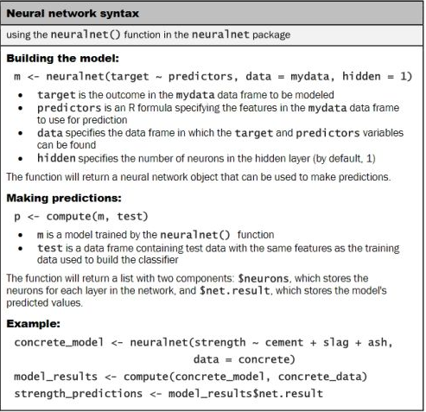

Slide 9
Numeric prediction
Contingency table or cross-tabulation or confusion matrix cannot be used to compare models.
Correlations between predicted and actual values in validation set is a good comparison criterion

Slide 10
Class exercise
Try with threshold=0.05
Try with act.fct=“logistic”

Slide 11
Support Vector Machine (SVM)
The goal of an SVM is to create a flat boundary, called a hyperplane, which leads to fairly homogeneous partitions of data on either side.
In this way, SVM learning combines aspects of both the instance-based nearest neighbor learning, and the linear regression modeling. The combination is extremely powerful, allowing SVMs to model highly complex relationships.

Slide 12
SVM (cntd.)
Recently gained a lot of popularity
Great performance
Use cases
Classification of genes
Text categorization
Detection of rare events such as failures, breaches, earthquakes

Slide 13
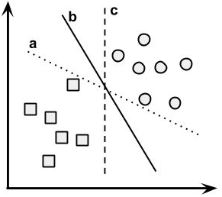
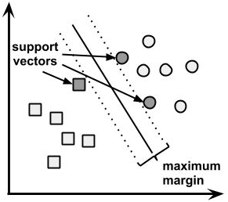
Linearly separable data
The task of the SVM algorithm is to identify a line that separates the two classes. Three such possibilities are labeled a, b, and c below:

Slide 14
Maximum Margin Hyperplane (MMH)
Hyperplane that creates the greatest separation between the two classes.
Support vectors (indicated by arrows in the figure that follows) are the points from each class that are the closest to the MMH; each class must have at least one support vector, but it is possible to have more than one.
Using the support vectors alone, it is possible to define the MMH.
This is a key feature of SVMs; the support vectors provide a very compact way to store a classification model, even if the number of predictors is extremely large.

Slide 15
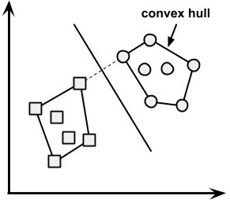
Linearly separable data (cntd.)
In this case, the MMH is as far away as possible from the outer boundaries of the two groups of data points.
These outer boundaries are known as the convex hull.
The MMH is then the perpendicular bisector of the shortest line between the two convex hulls.
Sophisticated computer algorithms that use a technique known as quadratic optimization are capable of finding the maximum margin in this way.

Slide 16
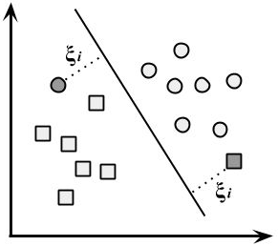
Non-linearly separable data
use of a slack variable, which creates a soft margin that allows some points to fall on the incorrect side of the margin.
The figure illustrates two points falling on the wrong side of the line (missclassified) with the corresponding slack terms.

Slide 17
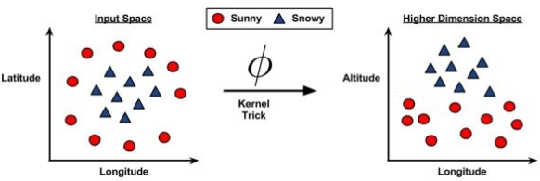
SVMs with non-linear kernels add additional dimensions to the data in order to create separation in this way.
It uses a kernel trick that involves a process of adding new features that express mathematical relationships between measured characteristics.
Like neural networks you would want to standardize variables, convert nominal variables to dummies and ordinal to scale.

Slide 18
Strengths
Can be used for classification or numeric prediction problems
Not overly influenced by noisy data and not very prone to over fitting
May be easier to use than neural networks, particularly due to the existence of several well-supported SVM algorithms
Gaining popularity due to its high accuracy and high-profile wins
Weaknesses
Finding the best model requires testing of various combinations of kernels and model parameters
Can be slow to train, particularly if the input dataset has a large number of features or examples
Results in a complex black box model that is difficult if not impossible to interpret

Slide 19
Commonly used kernels
Gaussian RBF kernel (good starting point)
Similar to RBF neural network
Linear kernel
Polynomial kernel
Sigmoid kernel
Similar to sigmoid activation function of neural network

Slide 20
Class exercise
http://www.packtpub.com/code_download/13251
Download data and code from the above link. This is Ch7 from the book: “Machine learning with R”.
Data is OCR data for 20,000 examples.
Classifying characters
Input is 16 different measures for a character
Examples from 20 different fonts
Open R-commander to upload the csv file from above

Slide 21
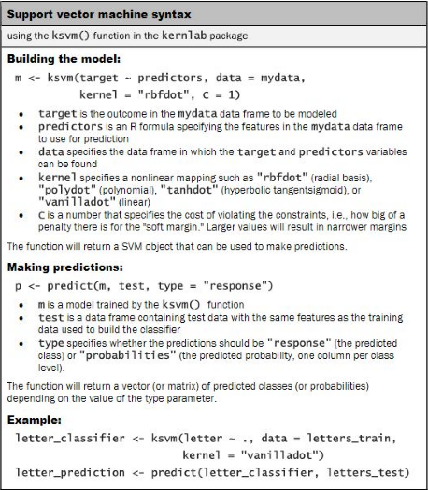

Slide 22
Class exercise
Try with different kernel—tanh
Try with different C-values

